Slide 1
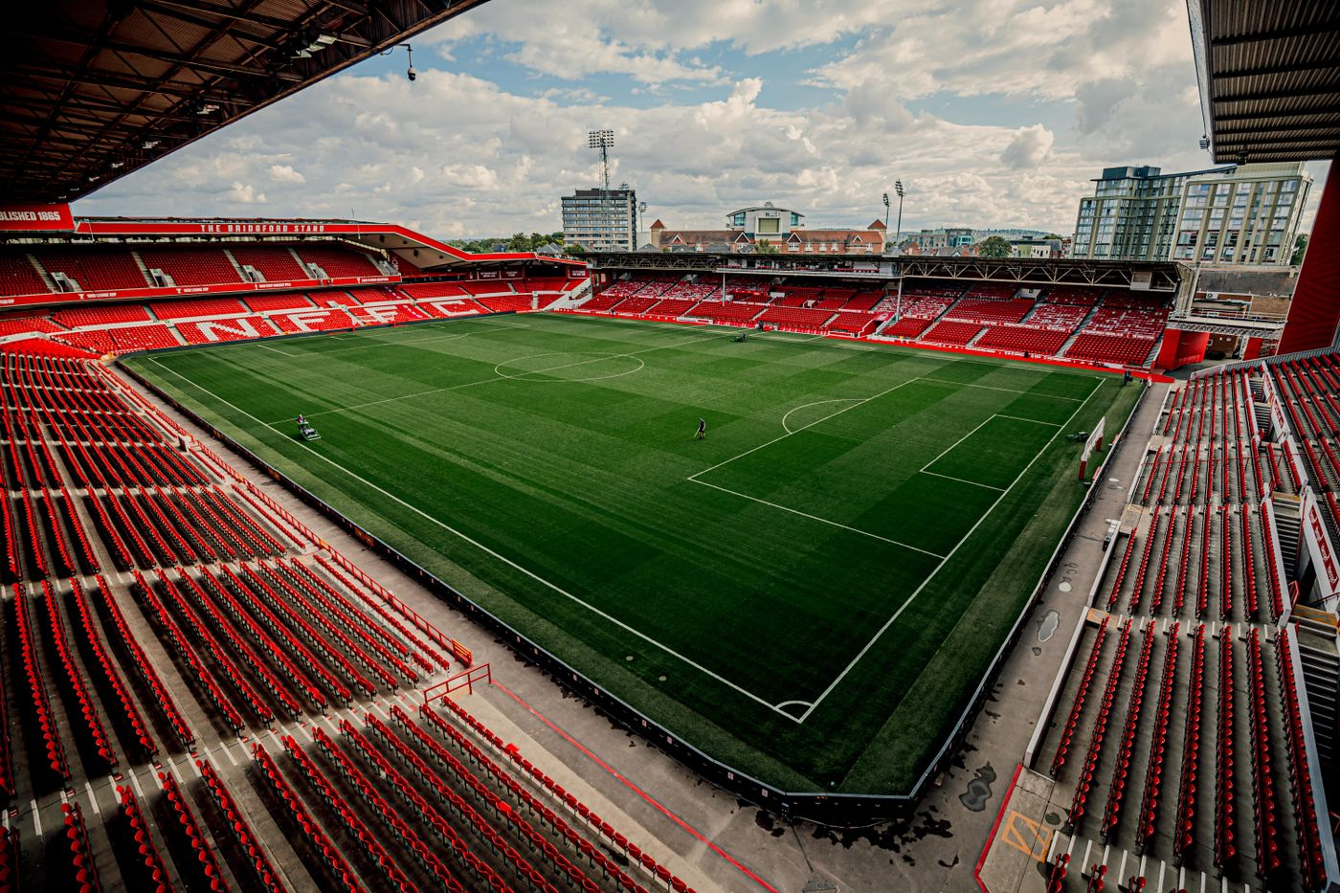
Nottingham Forest FC
Why are Forest doing so well this season compared to last season?
Is this just luck or shall I start looking at hotels in Europe?

Slide 2
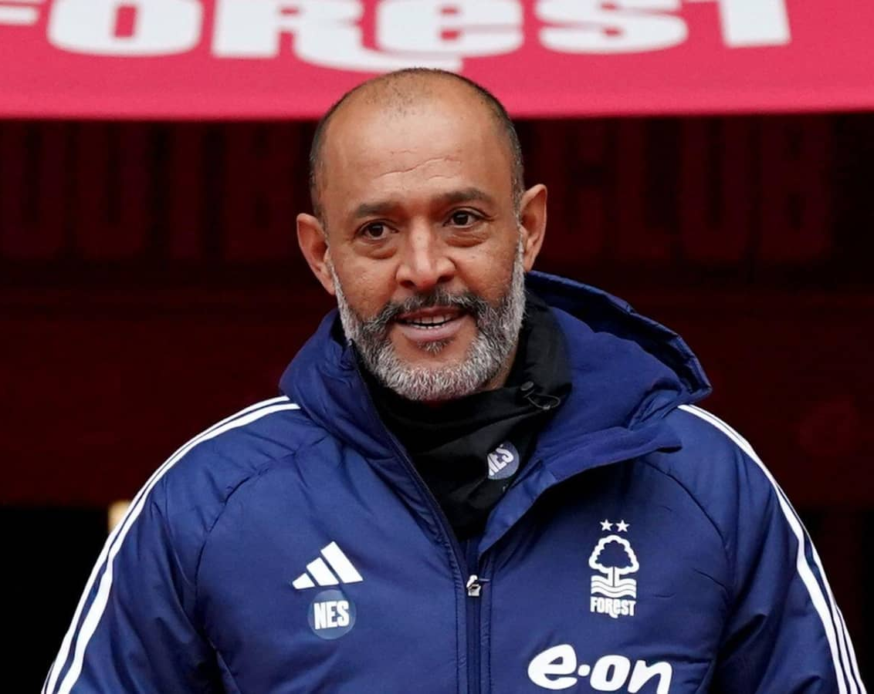
Context – Nottingham Forest FC
Steve Cooper
Forest were promoted to the Premier League (England's top division) at the end of the 2021/2022 season with manager Steve Cooper.
Forest have managed to maintain Premier League status avoiding relegation.
Forest fired Stever Cooper midway through the 2023/2024 season due to poor results and performances.
Steve Cooper was replaced by Nuno Espirito Santo shortly after who remains the current manager.
Nuno tends to employ a mid-block as opposed to Steve Cooper's low-block
A low-block involves a team defending with lots of players deep within their own half, in order to make it difficult for the opposition to score
A mid block is where the defending team compacts the middle of the pitch making it difficult for the opposition to pass the ball into the midfielders
Forest's main goal in the Premier League is to not get relegated but they are currently placed to qualify for the Europa League.
So my question is how did this happen? And are Forest due for a fall down the table?
Nuno Espirito Santo

Slide 3
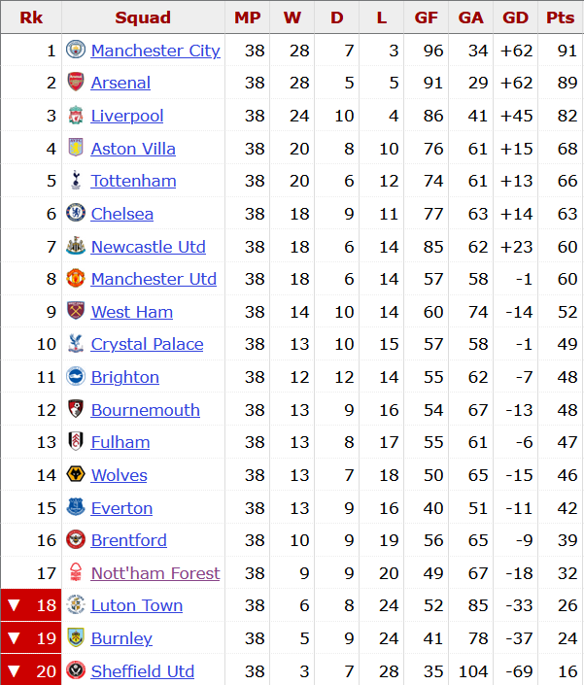
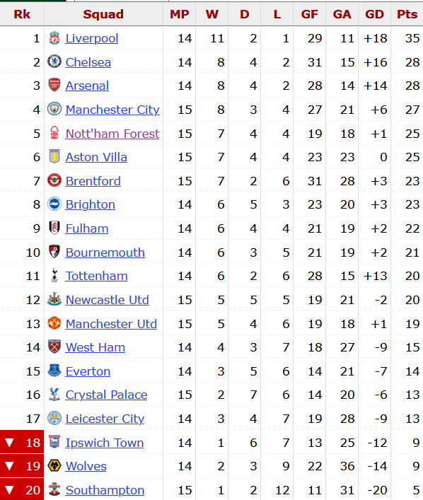

2023/2024
2024/2025

Slide 4
A Brief Look
2024
Overall Results |  |  | Home Results |  |  | Away Results
Result | Count | Percentage | Result | Count | Percentage | Result | Count | Percentage
W | 7 | 46.67 | W | 3 | 42.86 | W | 4 | 50
D | 4 | 26.67 | D | 2 | 28.57 | D | 2 | 25
L | 4 | 26.67 | L | 2 | 28.57 | L | 2 | 25
2023
Overall Results |  |  | Home Results |  |  | Away Results
Result | Count | Percentage | Result | Count | Percentage | Result | Count | Percentage
W | 9 | 23.68 | W | 5 | 26.32 | W | 4 | 21.05
D | 9 | 23.68 | D | 5 | 26.32 | D | 4 | 21.05
L | 20 | 52.63 | L | 9 | 47.37 | L | 11 | 57.89
This season Forest have won a much higher share of their games compared to last season
There is no longer the huge gap in home and away form. Nuno seems to have figured out a way to get results both home and away
But this doesn’t tell the full picture. We need to dive a bit deeper

Slide 5
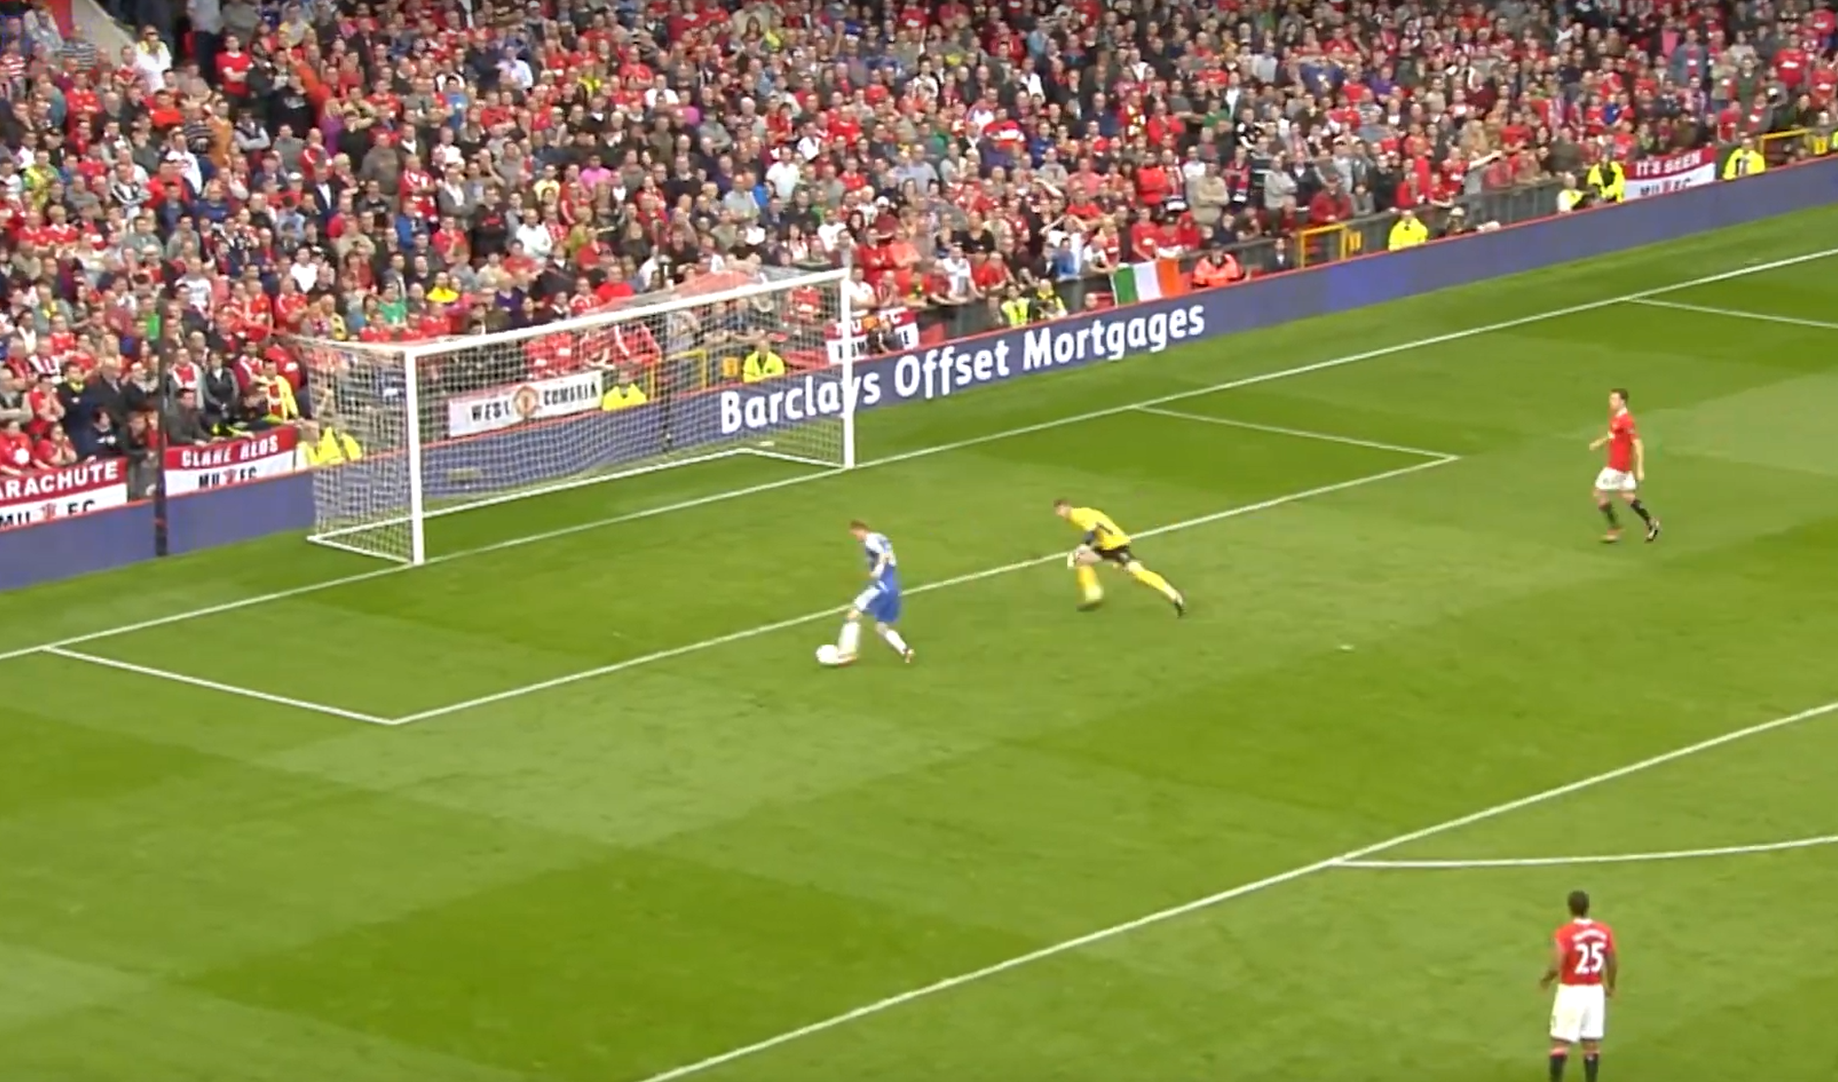
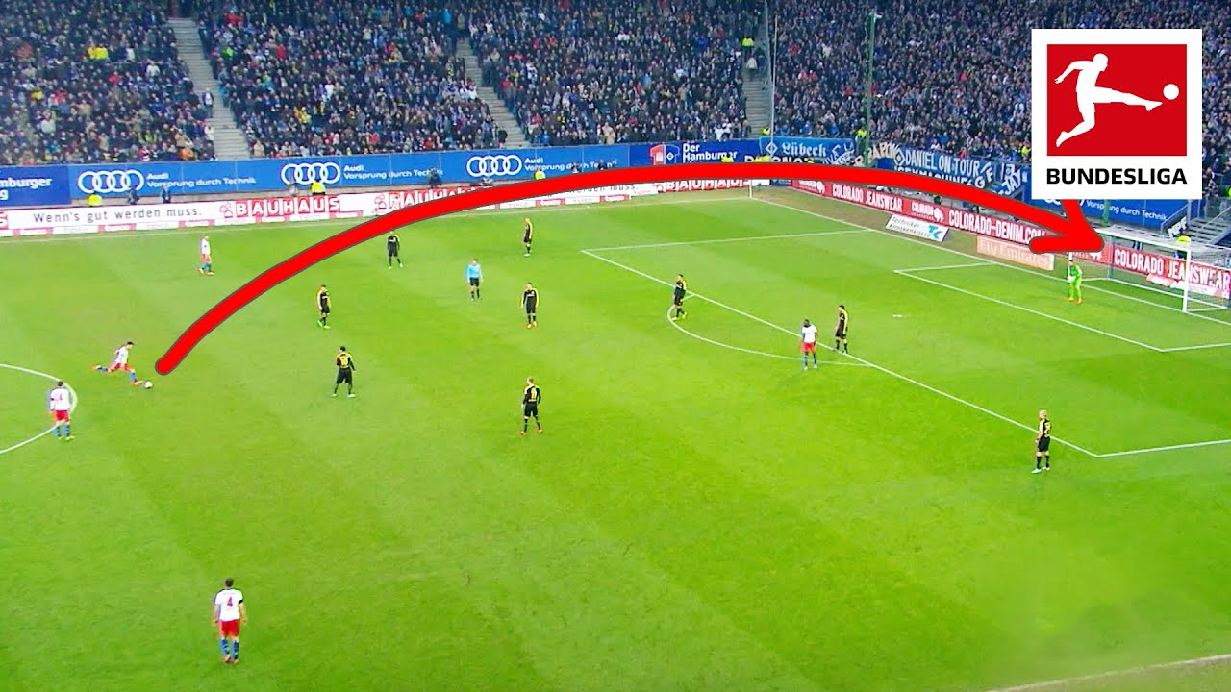
Context – Football Analytics
A high xG chance
(he actually missed this)
One main way to analyse football matches in a quantifiable way is to look at something called: Expected Goals (xG).
xG is essentially how likely a player is to score from a shot based on contextual criteria such as:
Distance from the goal, angle of the shot, type of assist (was the pass along the ground or in the air?), goalkeeper positioning and defender positioning to name a few.
Whilst xG is not perfect it does allow for a excellent level of quantification for something as complex as elite sport.
This can also be used to describe Expected Assists (xA):
Essentially how likely is it that a pass will lead to an assist based on where the ball is passed form and where the teammate receives the ball.
Recoveries are when a player regains possession for their team.
My question is could Forests performances recently be due to a massive disparity between xG and actual goals.
Essentially are Forest just getting lucky?
A low xG chance
(somehow this one goes in)

Slide 6
Nuno This Season (2024) vs
Last Season (2023
The biggest difference this season (2024) is the reduction in the amount of expected goals against and the number of goals against.
Note there is also a reduction in the teams xG this season compared to last.
This could be tell us that Nuno has a more disciplined game plan this season, not giving the opposition as many chances, which has lead to a reduction in xG produced.
This has also lead to the xG against Forest not being outperformed as drastically as it was last season, with forest conceeding about as many goals as they would be expected to (look to the Expected Goal Difference vs Actual Goal Difference)
Forest are also outperforming xG to a much higher margin this season compared to last. (luck swinging back their way).
Nuno 2024 | Average Possession
Combined | 40.33
Home | 48.57
Away | 33.13
Nuno 2023 | Average Possession
Combined | 41.14
Home | 39.09
Away | 43.4

Slide 7
Forest This Season – Home and Away
Forest this season have been highlighted for their incredible away form.
On first glance it seems that Forest are massively outperforming their xG in these away games.
(xG – GF) is at a massive –2.3 meaning forest on average have scored 2 more goals than would be expected away from home.
However, this can be balanced out when looking at the xG against Forest when they play away and teams have also been massively outscoring their xG against Forest.
Also note the Expected Goal Difference and the Actual Goal Difference.
Note the clear defensive counter-attacking style emphasised when away from home (only 33% possession).
But have started to take more control of home games having nearly 50% possession.
Forest have been underperforming their xG when at home.
However there is no statistical difference between xG and Actual Goals for and against the team.
This could be due to relatively small sample size due to this analysis being mid season.
 | Average Possession
Combined | 40.33
Home | 48.57
Away | 33.13
Goals | 19 | xG | 17.9
Goals Against | 18 | xGA | 16.7

Slide 8
Forest This Season
Game by Game: Home xG
These graphs track the xG vs Actual Goals for every home game this season
Can see the relatively close relationship between xG and GF
Correlation Coefficient between the two was 0.75 for both goals scored and conceeded
Forest don't seem to massively outperform xG on any given day, in fact they never outperform it by more than 1.
Forest usually overperform on GA where they mostly conceed less than expected
Usually a sign of good defence and the accumulation of low xG chances such as excessive long shots that are not likely to go in due to defensive strength
However game 6 they conceeded nearly double of what xG predicts
Mean Goals Scored Home 2024 | 1.14
Mean xG Home 2024 | 1.31
Mean Goals Conceeded Home 2024 | 0.86
Mean xG Against Home 2024 | 0.93

Slide 9
Forest This Season
Game by Game: Away xG
These graphs track the xG vs Actual Goals for every away game this season
Start to see a larger difference between xG and Actual Goals compared to at home
Correlation Coefficients drop to 0.34 for Goals Scored and 0.56 for Goals Conceeded
Goals scored is an area I want to focus on
Forest score more than predicted in most of their away games (5/8)
Also have bigger gaps between xG and Actual Goals compared to home games. Outperforming xG by nearly double on 2 separate occasions.
Goals Conceeded.
Forest conceed more than expected in most of their away games (5/8).
Worth noting games 6,7 & 8 were against elite opposition who are more likely to score low xG chances.
XG model appears to not fit as well when looking at Forests away games.
Appear to limit the oppositions chances well but still conceed, whilst also scoring more than xG predicts.
Could it be that xG doesn't model as well when playing counter-attacking football? XG not emphasising the "easier" chances that may come with catching a team on the break and underpredicting the value of the chances conceeded?
Correlation Coefficient = 0.34
Mean Goals Scored Away 2024 | 1.14
Mean xG Away 2024 | 1.31
Correlation Coefficient = 0.56
Mean Goals Conceeded Away 2024 | 0.86
Mean xG Against Away 2024 | 0.93

Slide 10
Key Players – Chris Wood
Chris Wood has been on fire for Forest this season. Scoring 10 goals in 15 appearances.
Massively preferred by Nuno over Cooper. Nuno appears to get the best out of him.
He has scored 52% (10/19) of Forests goals this season, making him the main goalscoring outlet for the team.
Chris Wood is an experienced striker so outperforming xG is not massively unexpected, but the degree to which is definitely not "normal"
This is an area of concern with how much he is outperforming his xG this season.
Decided to use non-penalty xG because forest notoriously got very few penalties last season.
Outperforming his xG by a rate of nearly 2x. Even the best striker in the league is nowhere near this level.
Salah has around 1.2 and he is an elite level forward.
Forest have cause for concern as due to his age (33) any injury which is common for his age would leave the team with a massive hole in goal scoring capability.
 | 90s | Goals (Non Penalty) | xG (Non Penalty) | Goals Per 90 (Non Penalty) | xG Per 90 (Non Penalty) | xG Outperformance
Chris Wood (2024) | 12.7 | 8 | 4.50 | 0.63 | 0.35 | 1.8
Chris Wood (Cooper) | 5.2 | 3 | 2.20 | 0.58 | 0.42 | 1.36
Chris Wood (Nuno) | 14.9 | 11 | 9.50 | 0.74 | 0.64 | 1.16

Slide 11
Key Players – Morgan Gibbs-White
Morgan Gibbs-White (MGW) has been a key player for Forest since he signed at the start of the 22/23 season.
He is an attacking midfielder so his role is to link the defence and the attack together. Scoring goals himself and setting up his teammates into positions they can score from.
MGW has seen a small decrease in his assist numbers compared to last season, but he has also been unlucky with his assists this year being lower than his xA.
This has been subsidised with an increase in his goal output per 90, with him finally outscoring his expected goals this season
Goal scoring has been an area he needs to improve on for a long time
However more importantly, MGW's chance creation has remained very similar to last year, with him averaging around 4 shot creating actions a game.
This is combined with a goal creating action every other game on average both this and last year.

Slide 12
Key Players – Morgan Gibbs-White:
Progression
MGW is contributing a similar number of progressive passes this season compared to last
However focusing on the pass distance shows that he has made shorter distance progressive passes – likely showing up due to the new mid-block employed this season
This is further highlighted looking at MGWs progressive carries (distance and quantity) and carries per 90 increasing this season.
(He has to carry the ball as he cannot pass it straight away due to the reduced distance between him and his attacking team mates)
The Successful take-on increase has accentuates his more ball-carrying approach this season.
(He has to take on opponents more often due to receiving the ball in a more congested midfield where he operates)
Overall MGW is again providing that necessary key link between attack and defence this season.

Slide 13
Key Players – Murillo
Murillo is a Central Defender who has played every single minute of Premier League football for Forest this year.
His defensive performances have somewhat decreased, with him making less tackles and interceptions per 90.
However due to the mid-block as opposed to the low block there is less defensive pressure on him to make tackles and interceptions.
The evidence of the mid-block is somewhat shown through his drastic increase in blocked shots, this can come from opponents taking long shots.
Murillo is unusual in that he likes to take-on players despite playing as a centre back, which he has improved at massively this season.
He has become more measured in when to take-on opponents, doing it less often per 90 but having much more success.
Finally the mid-block is shown through his over doubling of carries into the final 3rd, emphasising that the defence is pushed higher up the pitch, making it easier for Murillo to carry the ball into the final 3rd.
 | Clearances Per 90
Murillo 2024 | 6.07
Murillo 2023 | 6.06

Slide 14
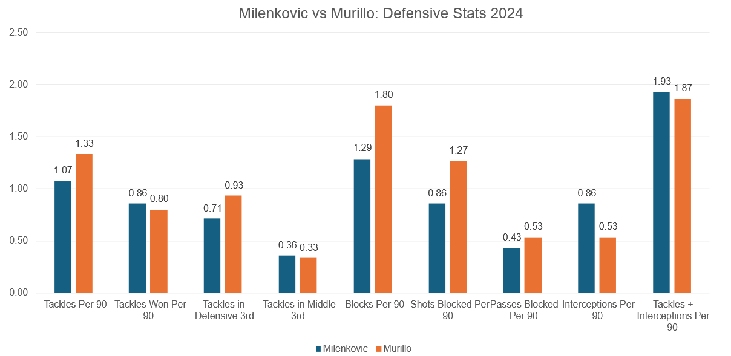
Key Players – Nikola Milenkovic
Milenkovic is a Central Defender partner to Murillo who has played every game that he has been available for.
He was signed at the start of the season and looks to be one of the reasons why Forest's defence has been so resiliant
He is a taller defender than Murillo who has less of an emphasis on taking players on and progressing the ball (he doesn’t actually try to take anybody on)
(An old school centre half)
Milenkovic shows his experience over Murillo, with his higher levels of interceptions per game and tackle success rate
The main thing Milenkovic brings is his incredible aerial presence due to this height. He essentially covers for Murillo's aerial weakness with this high aeriel duel success rate and high number of duels attempted per 90.

Slide 15
Conclusion
Forest this season appear to have found a formula for how to win games both home and away this season.
Taking more control in home games with higher possession stats and limiting the opponents xG. Allowing for the underperformance in home xG to not be an issue due to the lack of goals conceeded (conceeding less than 1 goal a game on average)
Away they conceed 1.375 goals a game on average
Away games Forest happily give up possession (only 33% on average) but instead make their possession count and score more often than xG might predict.
XG doesn’t seem to predict Actual Goals both for and against Forest. Forest's way of playing might not suit current xG models
New signing Milenkovic has helped tighten up the defence and allow the more attacking minded players to shine.
Chris Wood is having a generational season with some outrageous scoring numbers.
Overall Forest do appear to be riding their luck when it comes to some of their away victories, scoring more than anticipated in some games and not conceeding as much as they should be in others.
Lack of quality squad depth could prove to be Forest's undoing.
Any injuries to big players such as Chris Wood or any of the Centre Backs would be a disaster. Forest are very reliant on these players with them playing in every game this season for Forest so any injuries to these players would result in a significant drop in the fantastic xG conversion rate (thanks to Chris Wood) or a potential for goals to start leaking in again (Murillo and Milenkovic).
Finally, Forest are probably due for a slight fall down the table due to some results that might not perfectly reflect xG model predictions. This combined with Chris Wood's incredible xG outperformance alongside the fact he is scoring around half of the teams goals leads me to believe he is probably due for a cold streak at some point this season, which would result in Forest dropping down the table without his goals.
(The European flights might have to be on hold this year)

